Slide 1






Characterizing the Images of Black Hole Shadows
Sean Dougall

Slide 2
Images of the shadow
The images show a brightness ring surrounding a brightness depression
Shadow shape and sizes are determined entirely by the Theory of Gravity
The size of the brightness ring varies depending on the plasma physics surrounding the black hole
In order to test Einstein’s Theory of General Relativity, we must be able to determine the shadow size from observation
Notes:
Note: Talk about main goal of project, i.e want to use observation of the photon ring as a proxy for shadow size when the ring is narrow, we expect the photon ring to be close to the black hole shadow, include error”
MAD – Magnetically arrested Disk

Slide 3
Project
We wanted to use the bright emission as a proxy for the shadow size
To characterize black holes by the width of the bright emission
Processed and analyzed a large selection of varying numerical simulations using Image Domain Analysis Techniques
Notes:
Note: Talk about main goal of project, i.e want to use observation of the photon ring as a proxy for shadow size when the ring is narrow, we expect the photon ring to be close to the black hole shadow, include error”
MAD – Magnetically arrested Disk

Slide 4
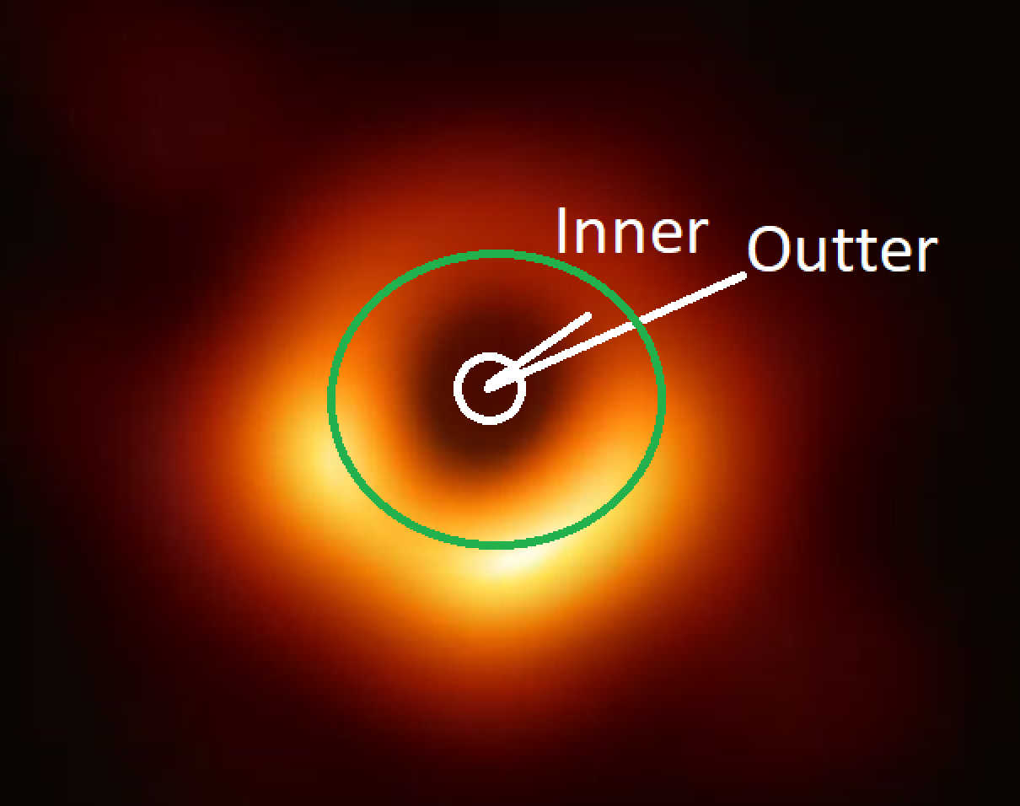
Image Domain Analysis
From center, Image is scanned radially outward
  Distance to Peak Emission (Radius)
  Size of Brightness Emission
  Through all azimuthal angles
Notes:
Include picture from Paper 6, Figure 14

Slide 5
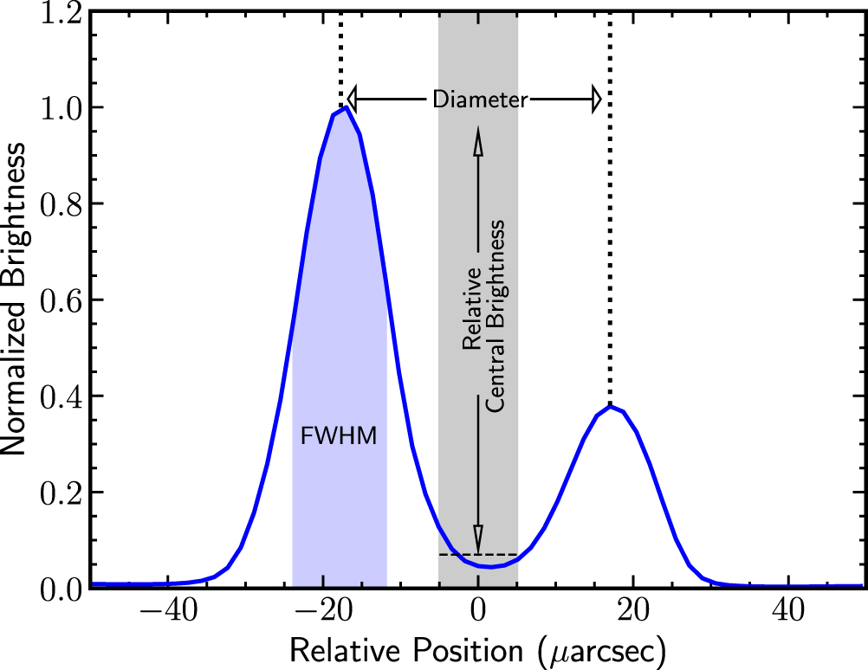
Image Domain Analysis
From center, Image is scanned radially outward
  Distance to Peak Emission (Radius)
  Size of Brightness Emission
  Through all azimuthal angles
Event Horizon Collaboration et al, 2019
Notes:
Include picture from Paper 6, Figure 14

Slide 6
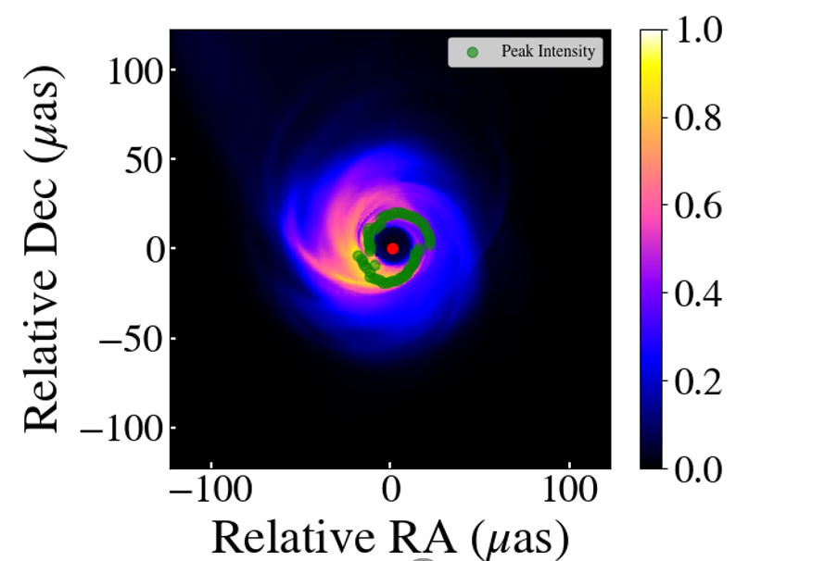
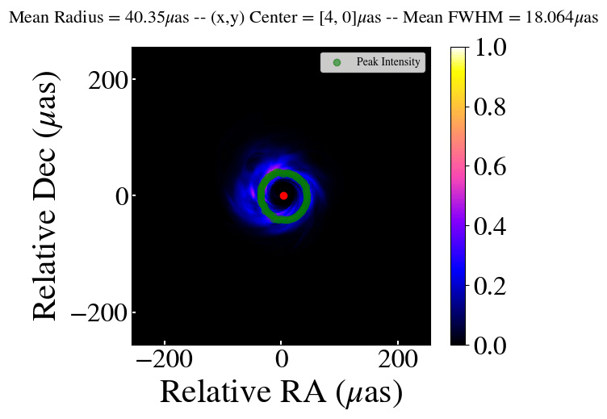
Image Domain Analysis

Slide 7
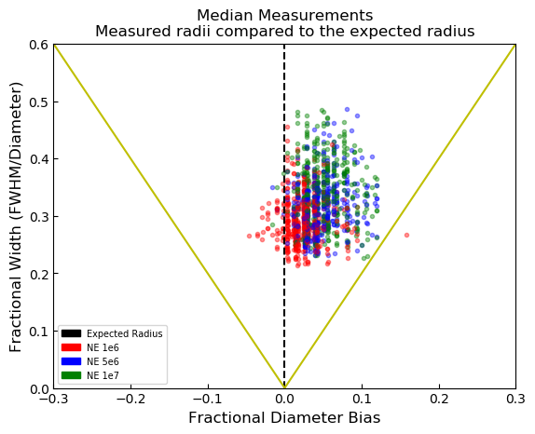
Results
Median radii compared to expected radii
We find that the emission rings are never larger than the black-hole shadows by more than half the widths of the rings themselves
These results supports using the emission rings as proxies for testing Einstein's theories.

Slide 8
Acknowledgments
I’d like to thank the following for the help and support given throughout the project:
  Dimitrios Psaltis
  Feryal Özel
  Lia Medeiros
  Tyler Trent
  Kaushik Satapathy
  University of Arizona

Slide 9
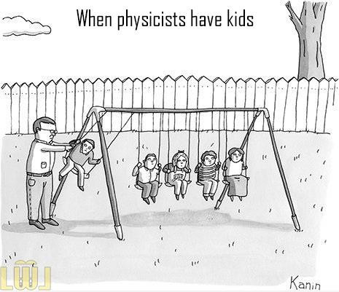
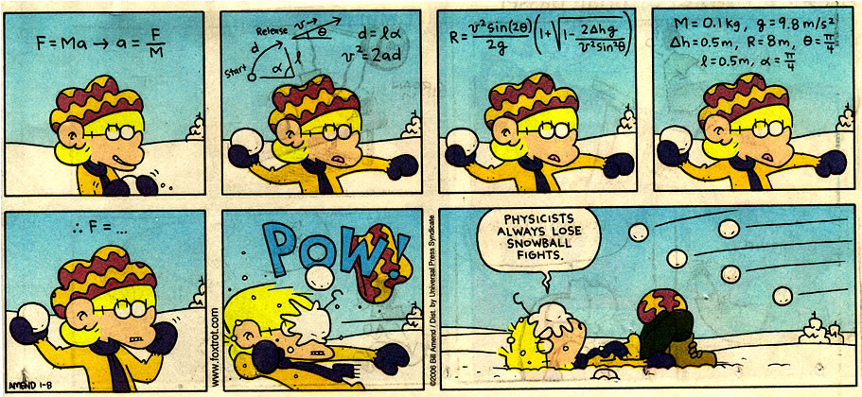
Thank you!

